Slide 1


Technology in aged care
Digital literacy
Notes:
To create Em dash above headline:
Same size and weight as the headline and set using a soft return.
PC: Em dash (—): Alt+Ctrl+ - (minus)
Mac: Em dash (—): Shift+Alt/Option+hyphen

Slide 2
Welcome
Class plan
Log into intranet
Access and respond to internal communications on message board
Record information into digital forms

Slide 3

How do you record information into a digital form?

Slide 4
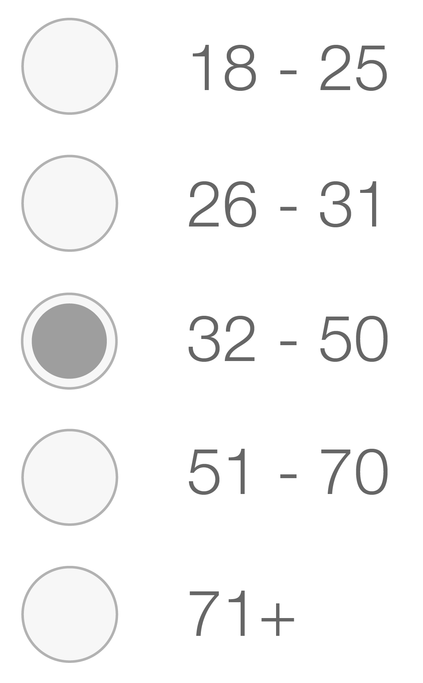
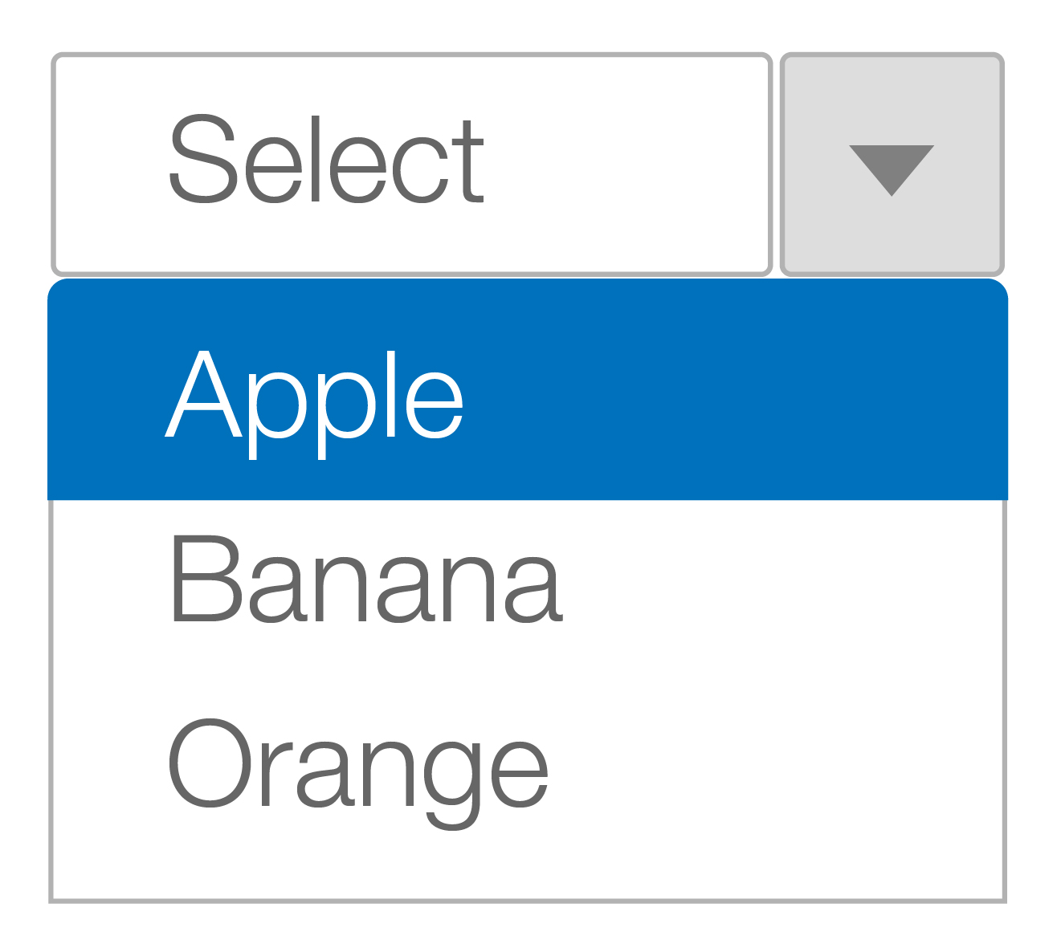
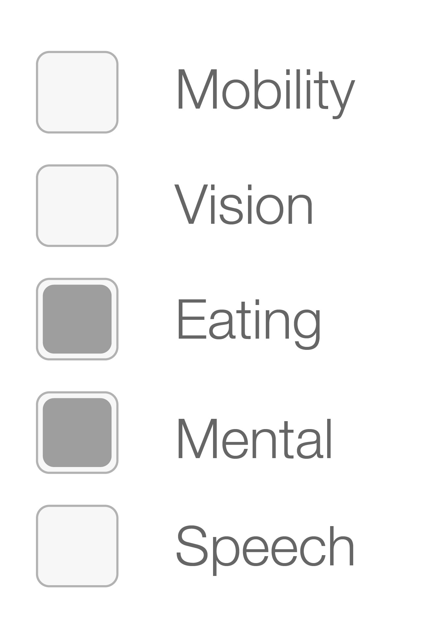
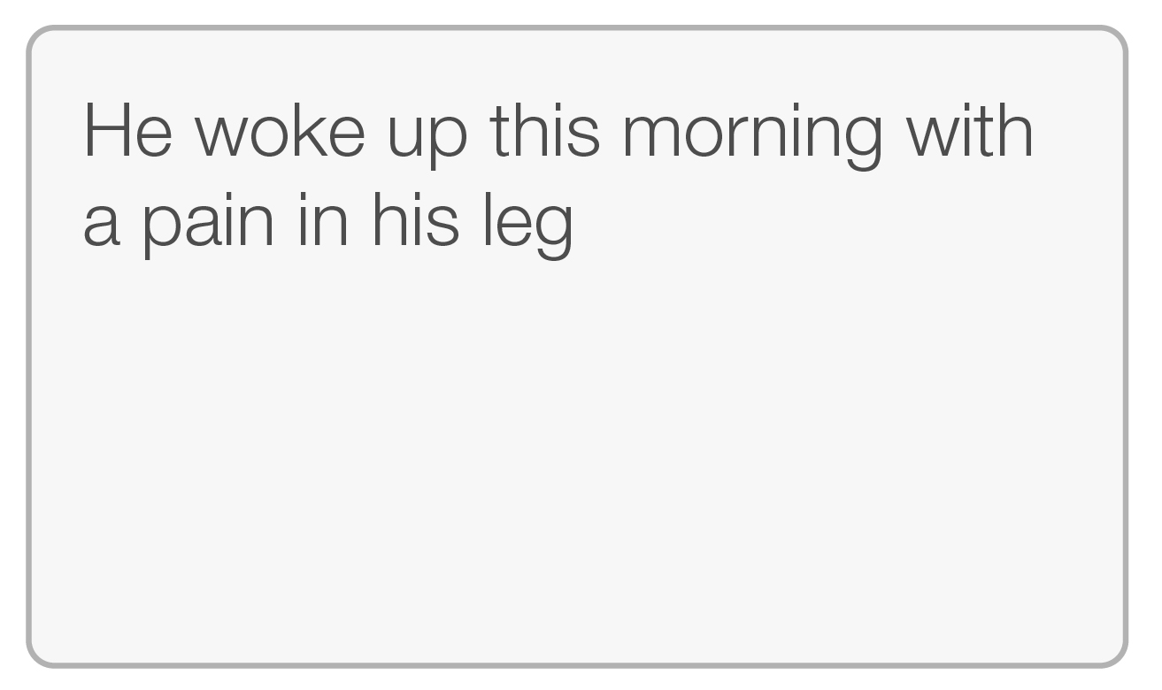
Recording digital information
Radio buttons
Drop downs
Use radio buttons when your
question has only one answer
This is a drop down this can be used to select from a list of items
Check boxes
Text box
Use checkboxes when your questions have more than one answer
A text box is used to input larger statements

Slide 5

Definitions
What is the difference between the Internet and the Intranet?
Intranet
Internet

Slide 6
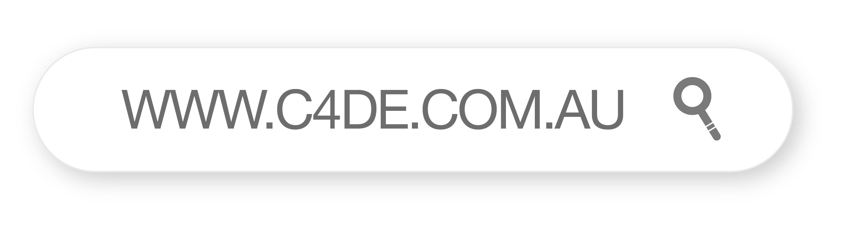
Definitions
Open the project.

Slide 7
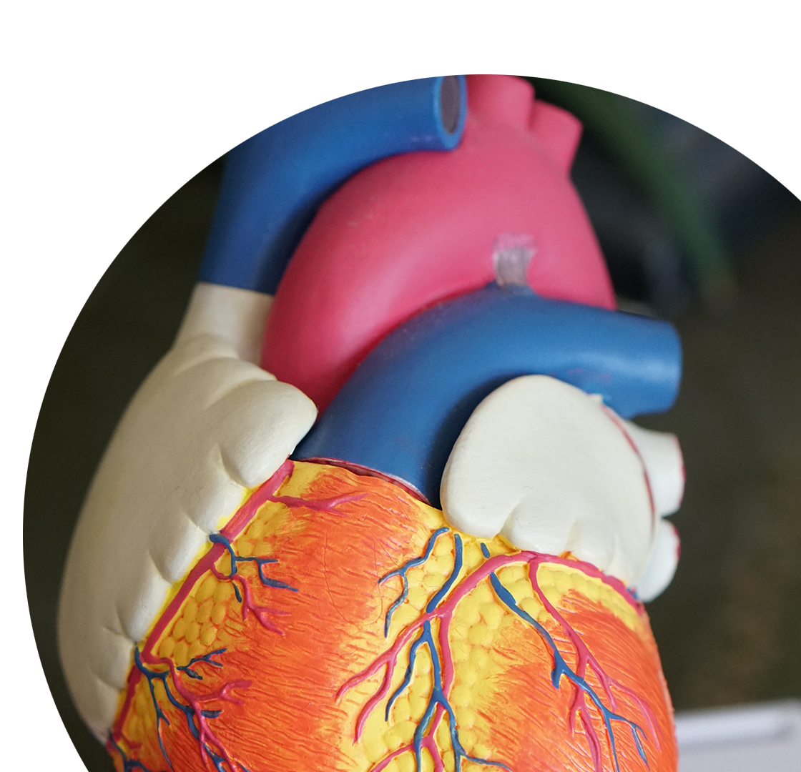
Activity
Food and
fluids activity

Slide 8

Food and fluids activity one
Menu
Tomato and cheese sandwich
Sliced apple
Hardboiled egg
Chocolate chip cookie
Cup of tea

Slide 9

Food and fluids activity two
Menu
2 slices of pizza
Cup of Yoghurt
Bran muffin
Black coffee

Slide 10
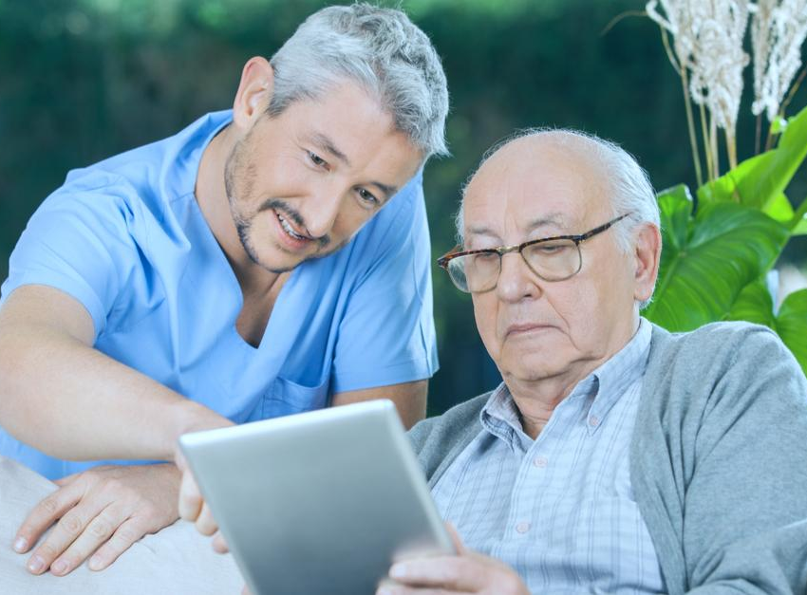
Activity
Personal care activity

Slide 11
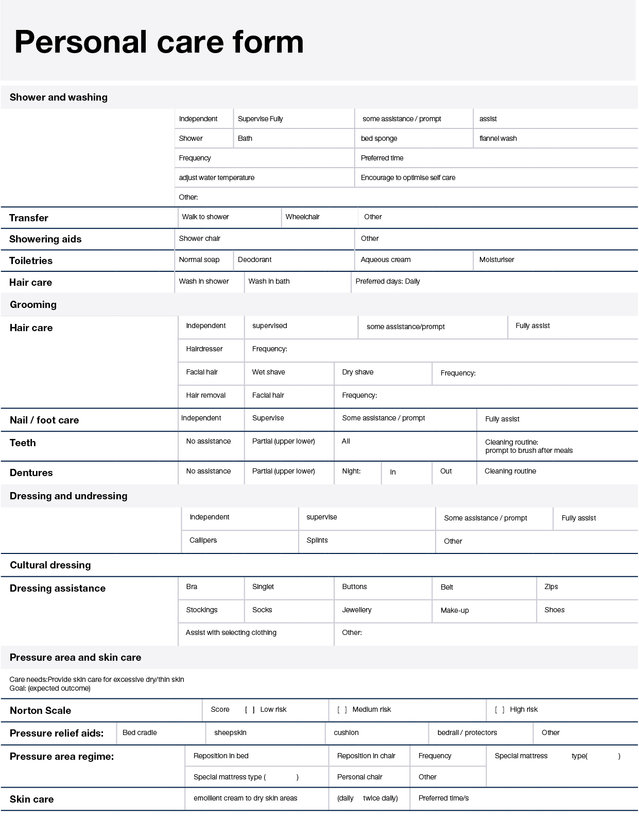
Personal care plan

Slide 12
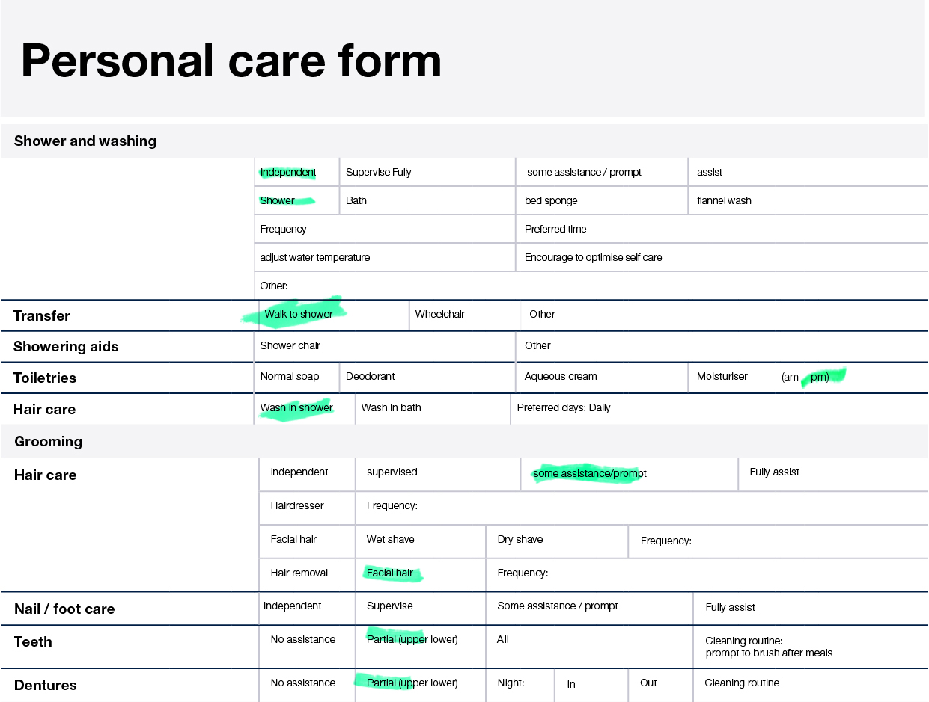
Personal care plan
Care plan
Showering, dressing, grooming
Care needs: Provide supervision with personal care tasks as unsteady in shower.
Goal: (expected outcome) Adequate personal hygiene be maintained
Today was an unusual day because this resident needed to be put through their routine quicker than usual because they had an appointment with a specialist. You gave much more assistance than normal to get this person out on time. Make a note of this in the comments.

Slide 13
Great work
Congratulations!
You have completed the Digital literacy in Aged care activities.

